Slide 1
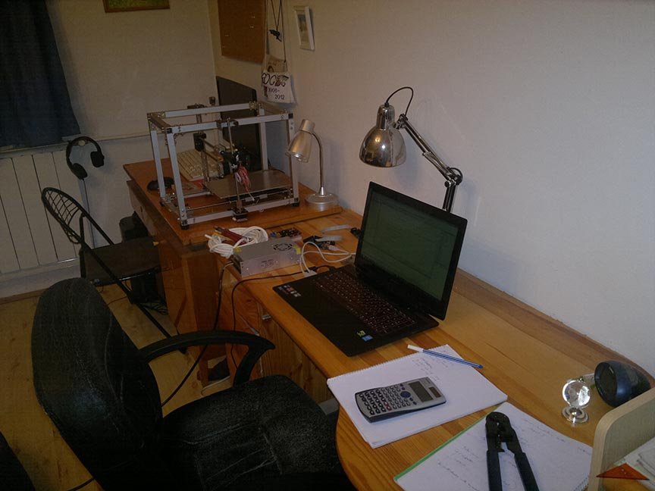
Building a 3D printer
By Szilárd Szabó University of Óbuda, Kandó Kálmán Faculty of Electrical Engineering
2016 spring

Slide 2
Motivations
3 engineer in family
Can print out parts for future projects
Learning
Possibly future of 3D printers

Slide 3
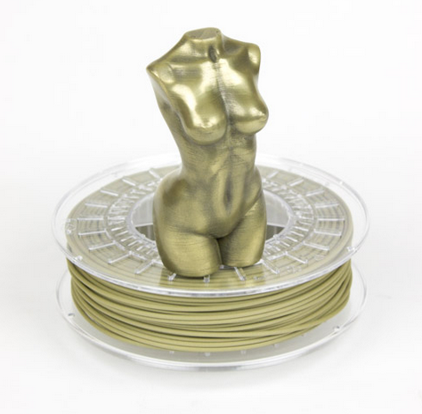
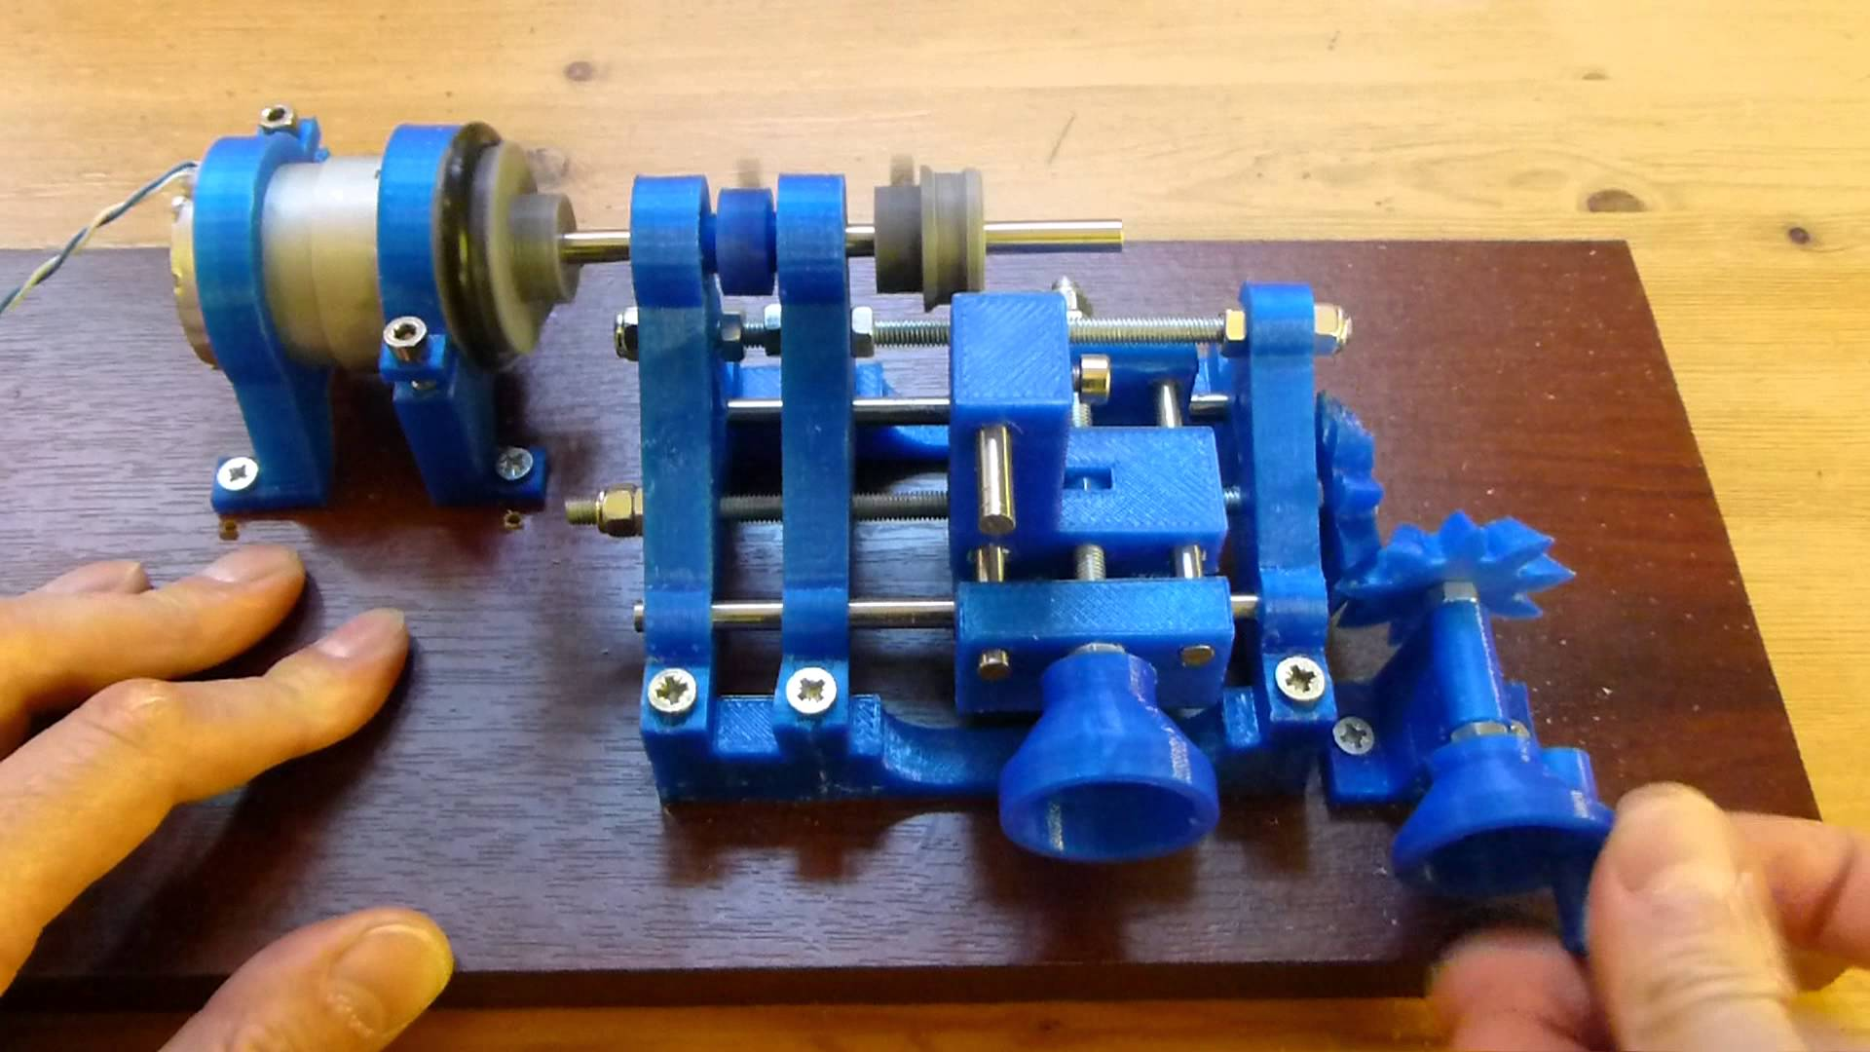
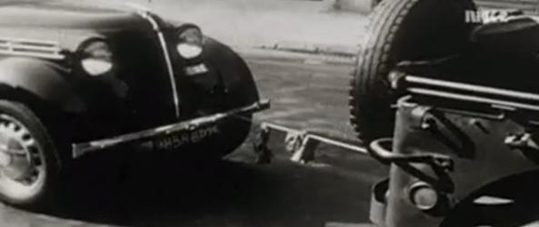
Materials
PLA
ABS
Carbon fiber
Nylon
Brass
Bamboo

Slide 4
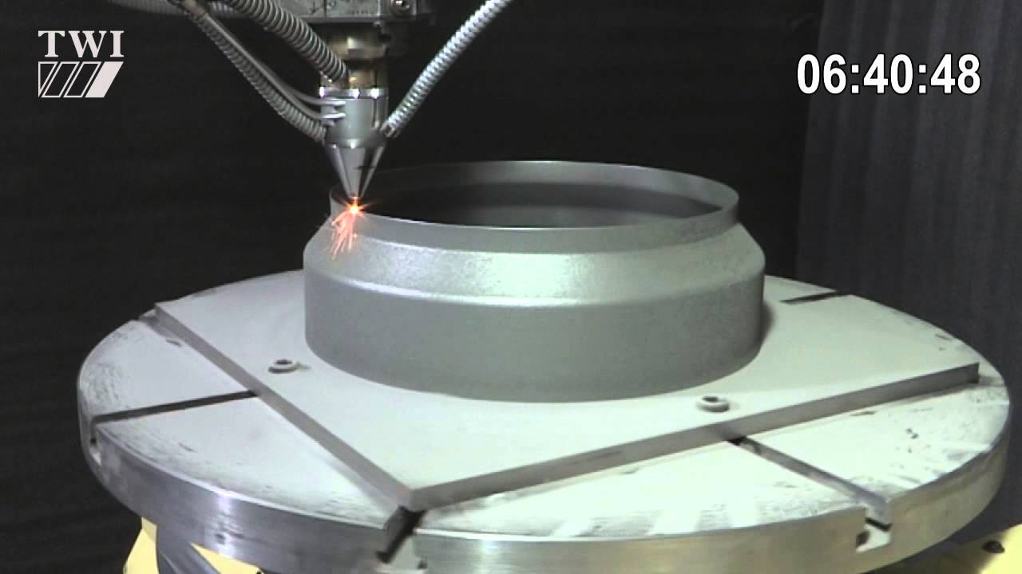
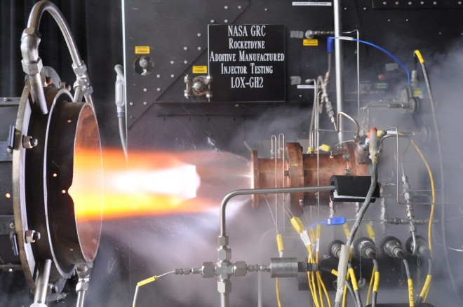
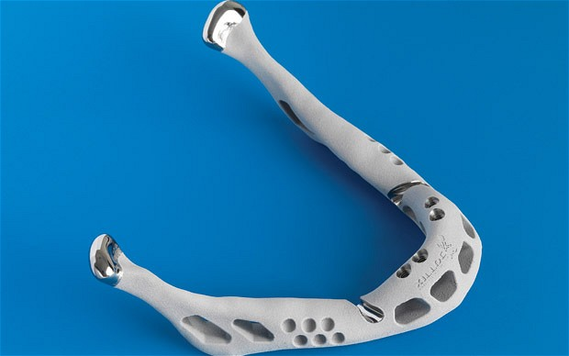
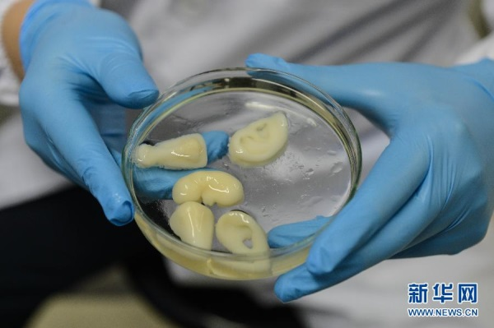
Other curiosities

Slide 5
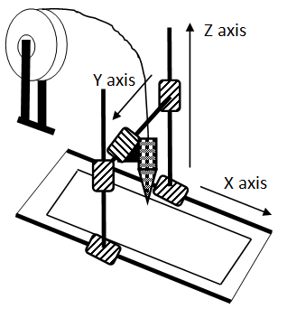
Requirements for a 3D printer
Mechanical aspect
Electronic aspect
Programming aspect
Planning
Consultations
Documentation
Presentations

Slide 6
Mechanical part
~45 hours of building.
~20 hours learning, searching, ordering, shopping, looking for equipments.

Slide 7

Shopping for materials

Slide 8
Shopping for materials
ebay.co.uk
mailing with international parties
DHL was super fast
Bauhaus
6 m aluminum profile
More than 1kg of bolts and nuts
Steel conrer elements

Slide 9
Shopping for materials
hestore
cables, cable ends, tools, programmer
vatera
power electronics, some spare parts

Slide 10

Getting the materials

Slide 11
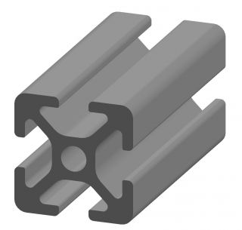
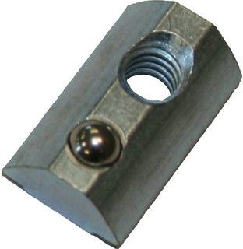
Shopping for materials
ebay.co.uk
mailing with international parties
DHL was super fast
Bauhaus
Their primary business profile is not 3D printer parts.

Slide 12
Shopping for materials
hestore
Long way there at friday.
vatera
Dealing behind the scenes.
Things arrived faster from UK.

Slide 13
Frame
Aluminum
No rust
Stiff
Formable
Time consuming
272 bores
Aluminum flakes
Box shape
Stiffness
Coverable
Can be packed on it.

Slide 14
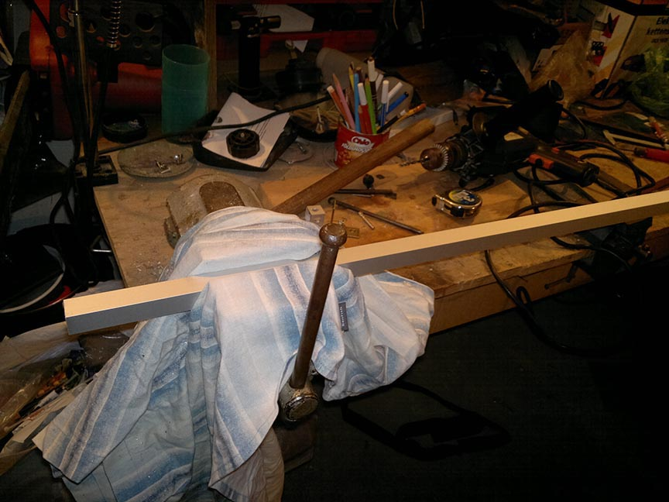

Slide 15
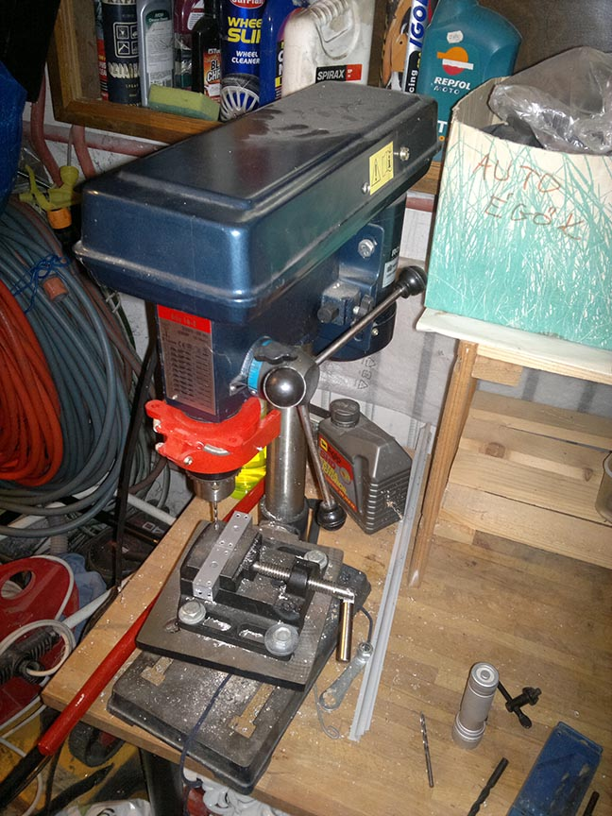

Slide 16
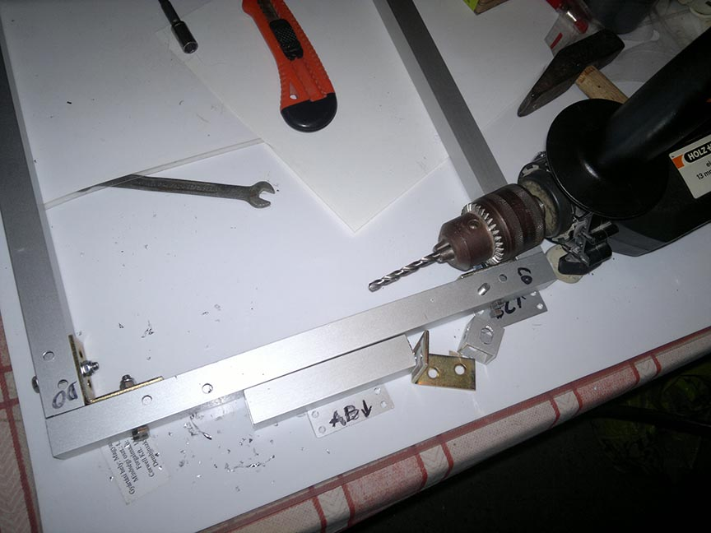

Slide 17
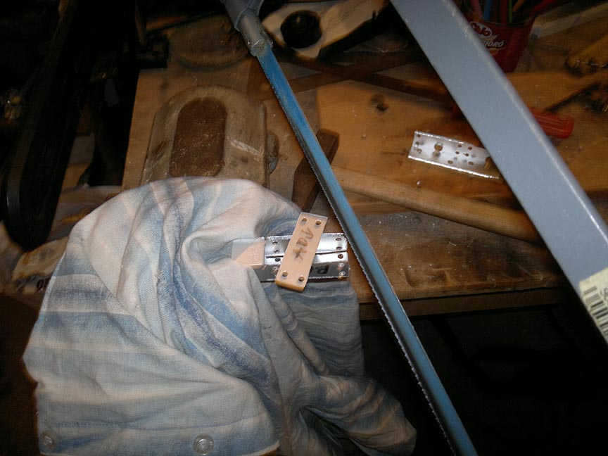

Slide 18
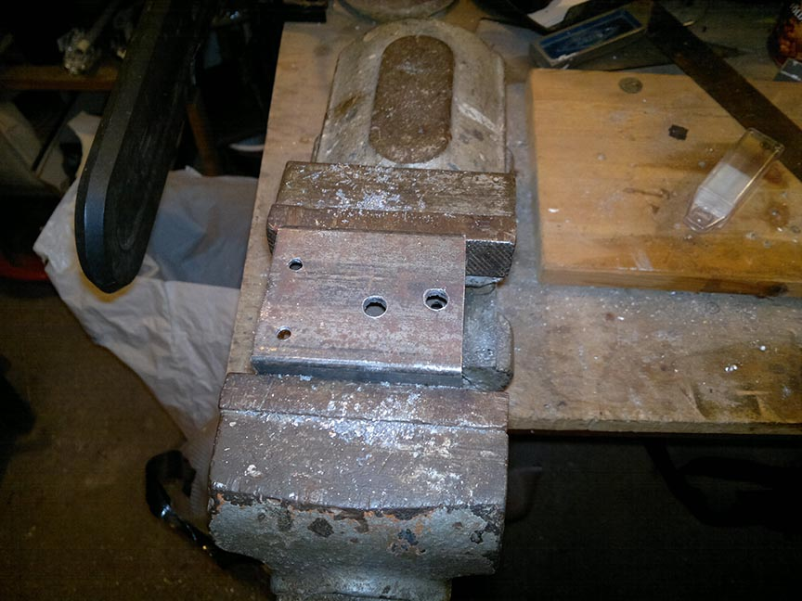

Slide 19
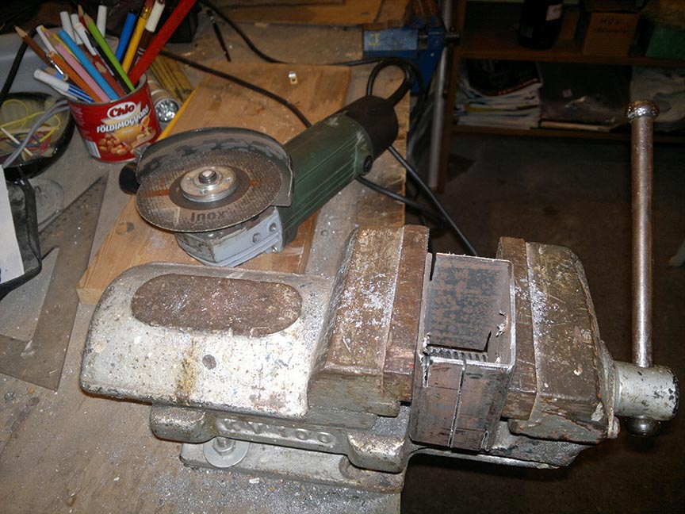

Slide 20
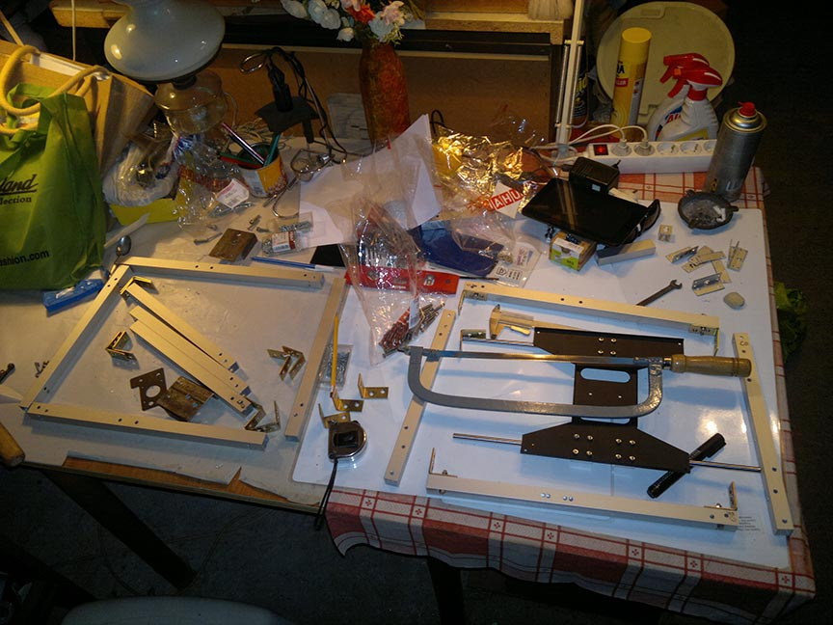

Slide 21
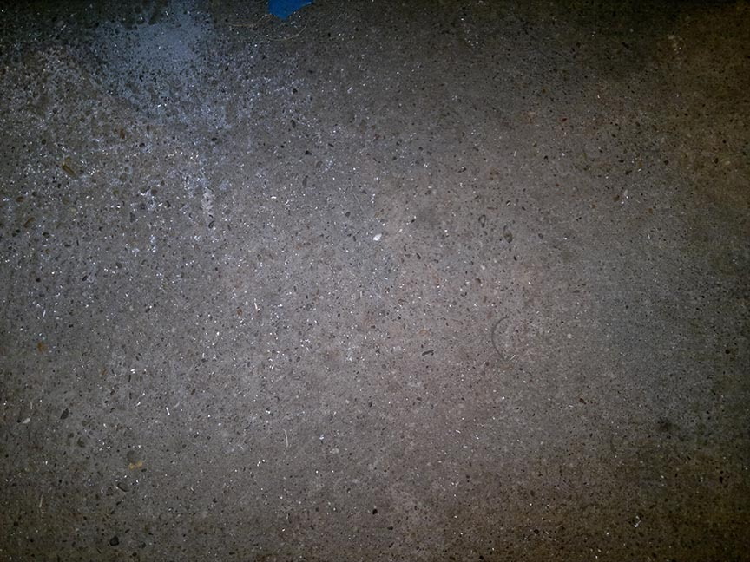

Slide 22
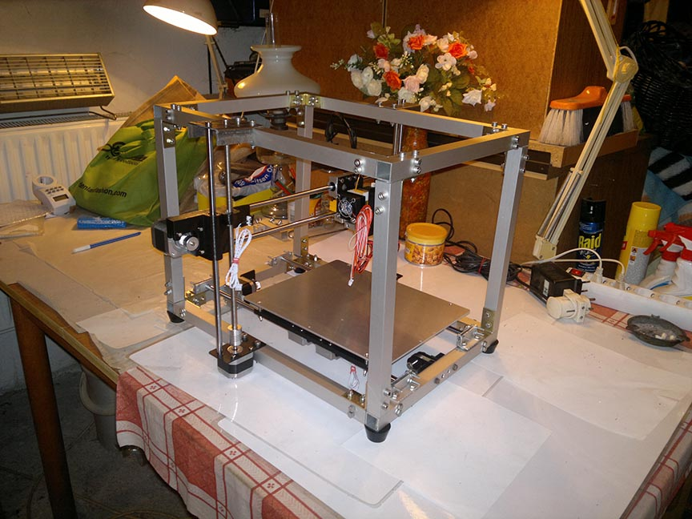
Assembly
Took 2 days
About 200 screws.

Slide 23
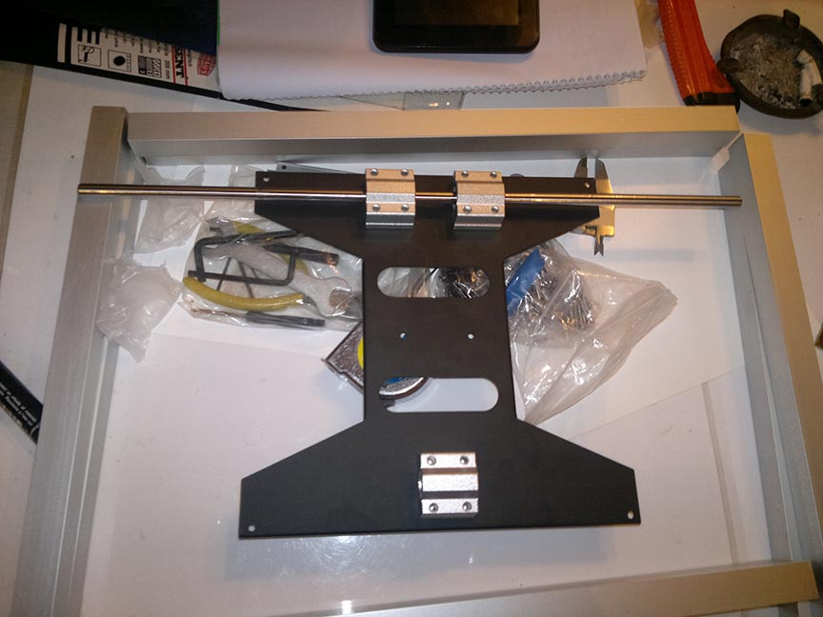

Slide 24
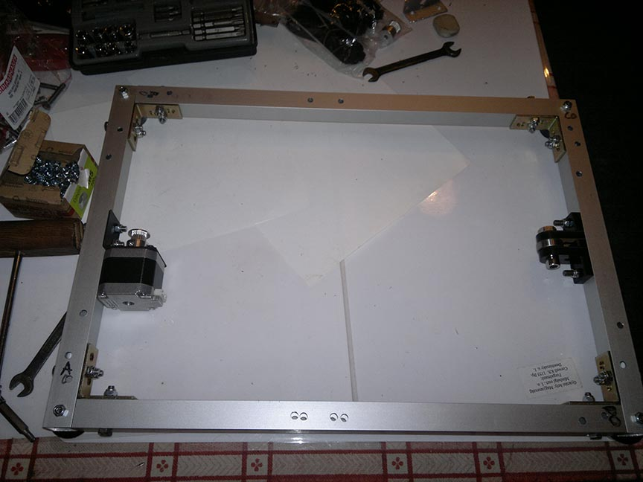

Slide 25
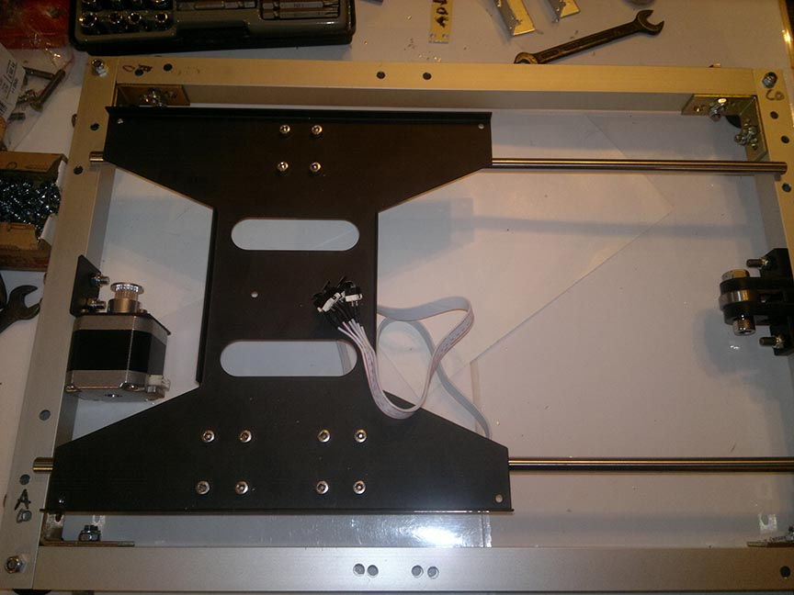

Slide 26
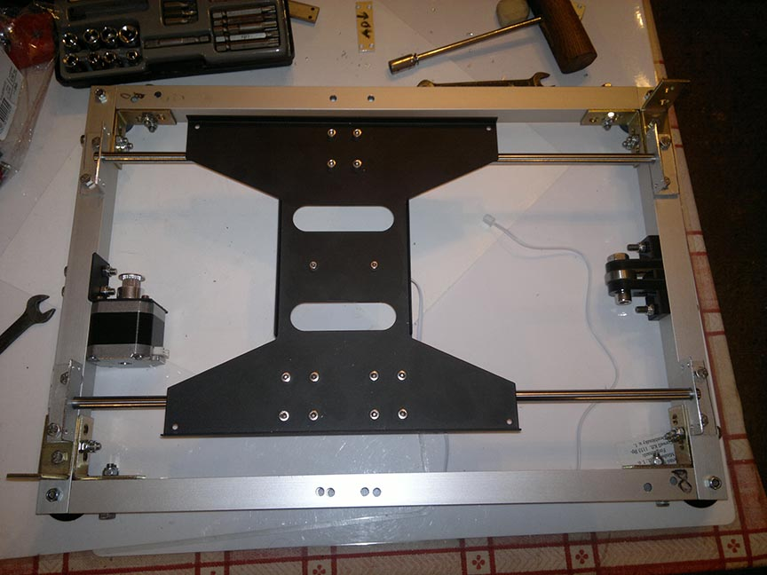

Slide 27
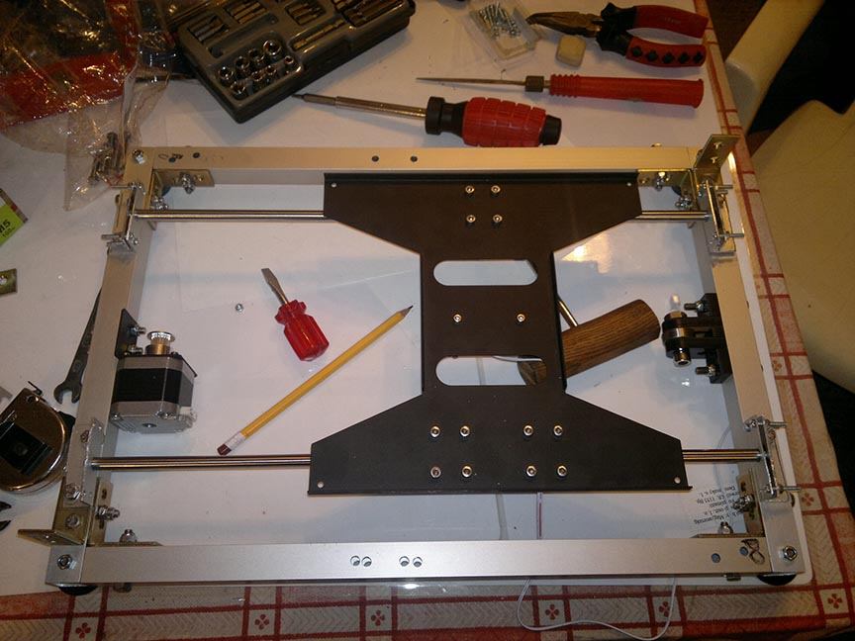

Slide 28
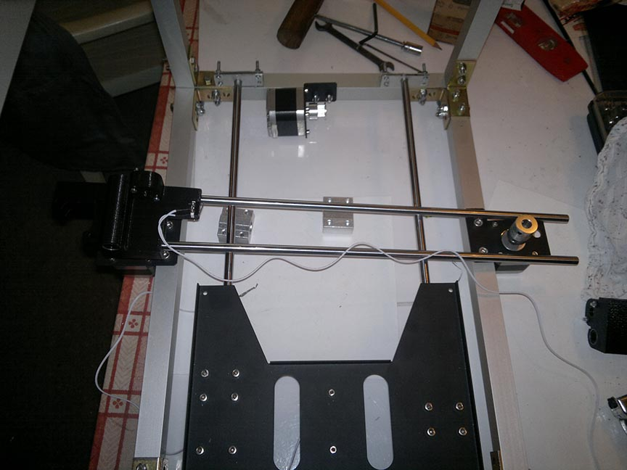

Slide 29
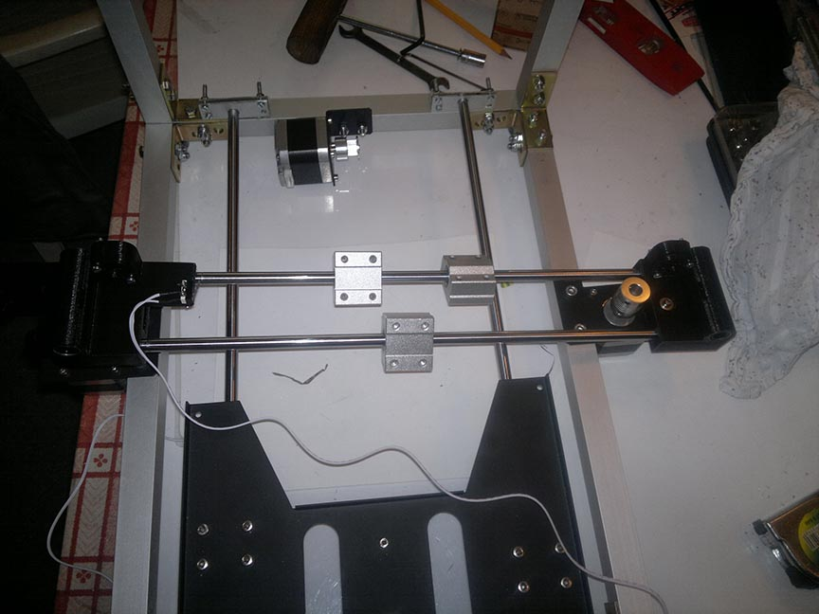

Slide 30
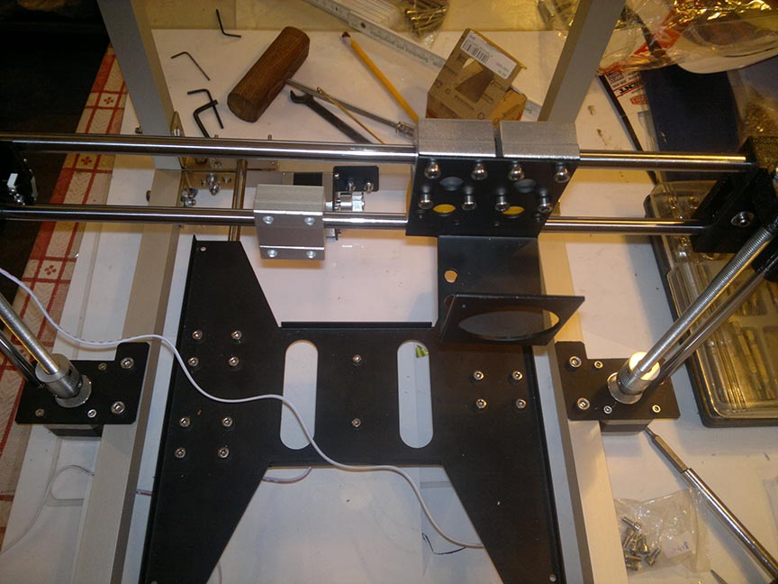

Slide 31
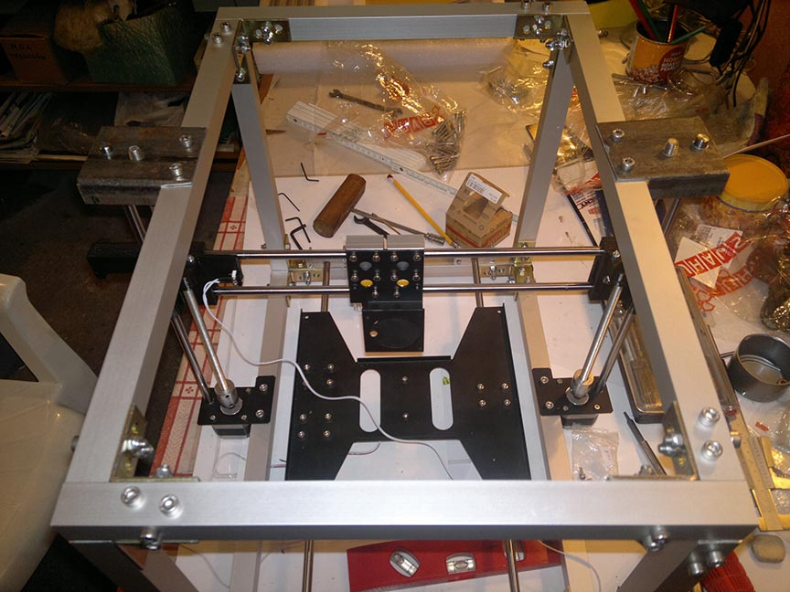

Slide 32
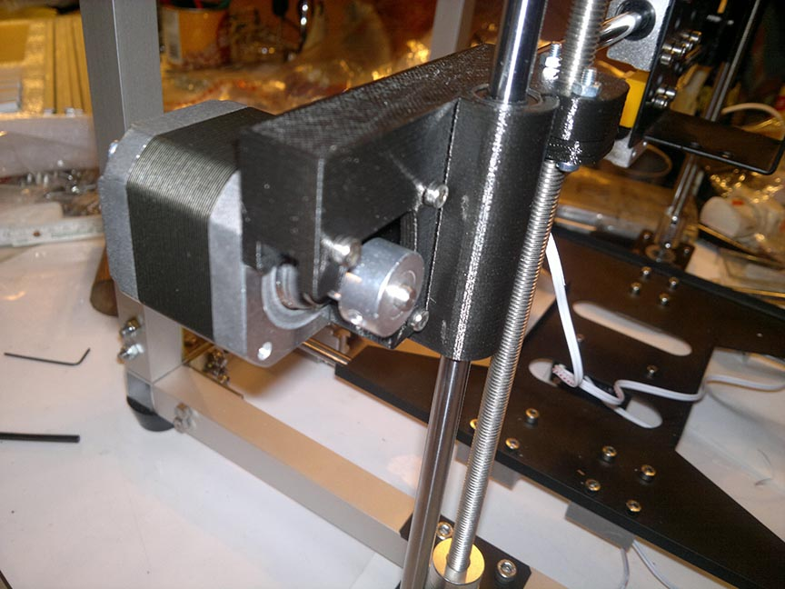

Slide 33
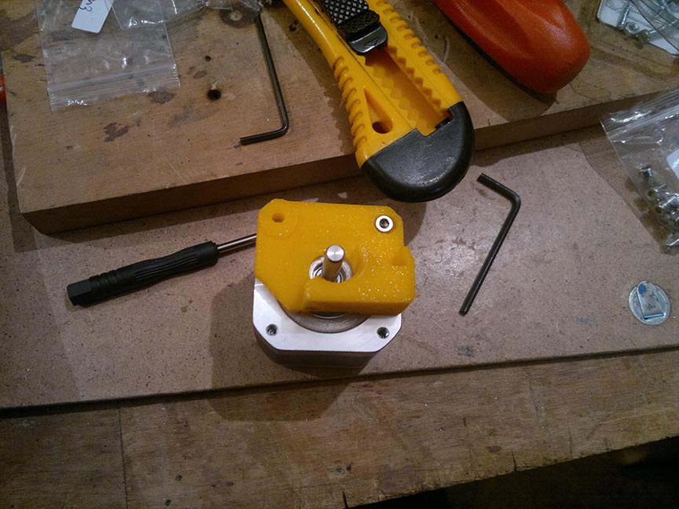

Slide 34
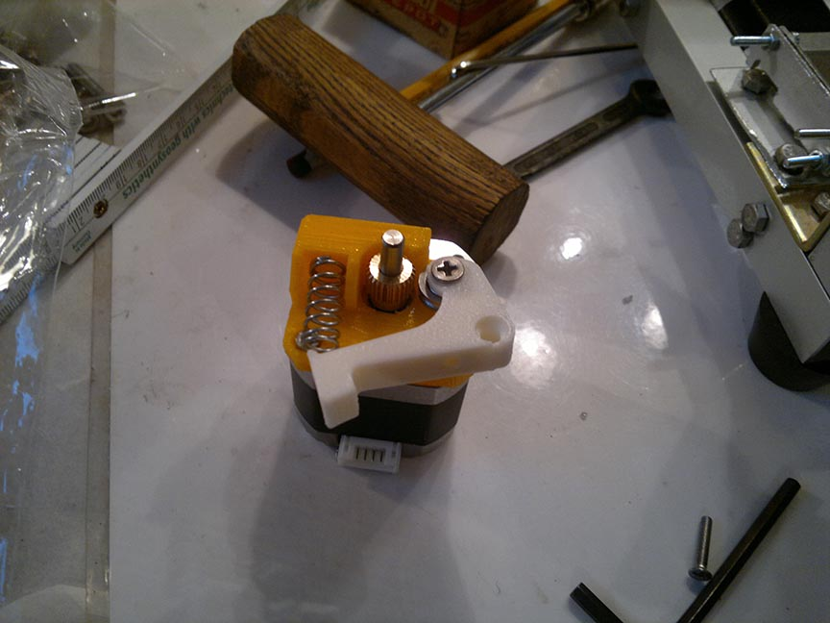

Slide 35
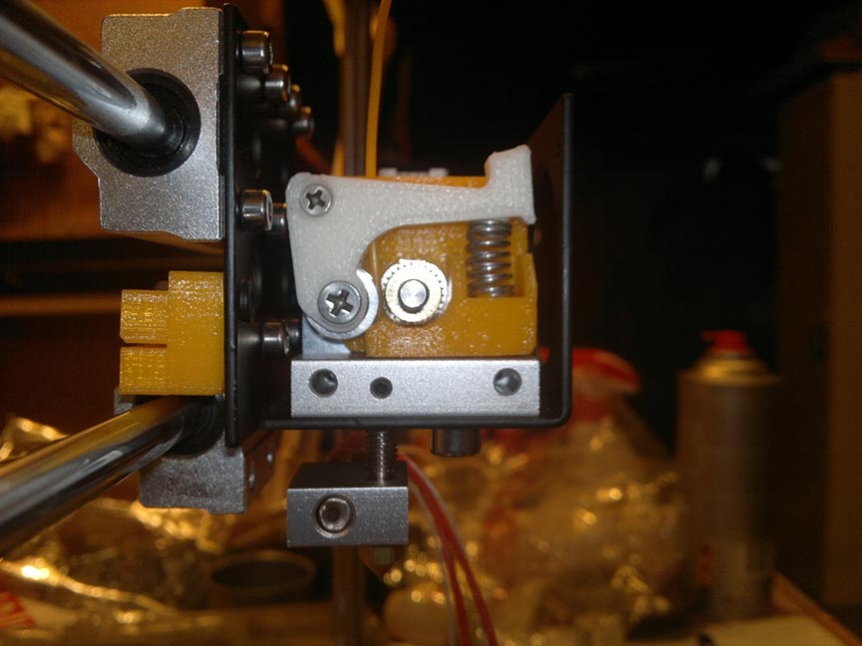

Slide 36
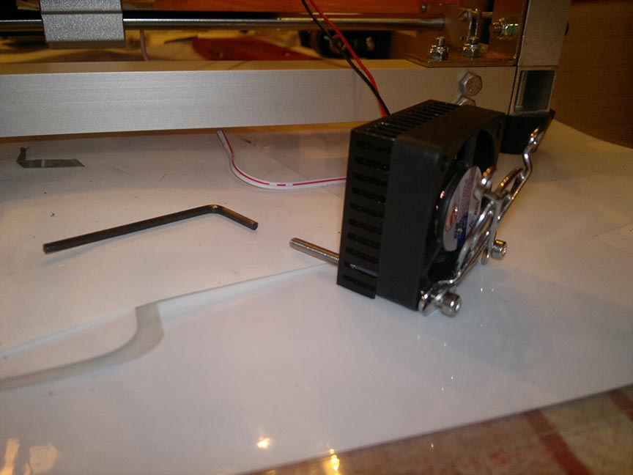

Slide 37
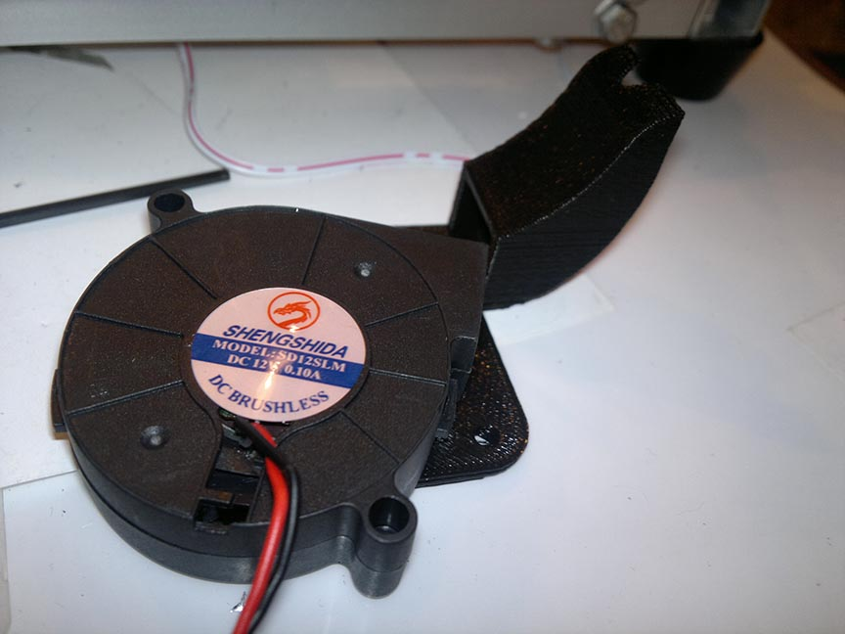

Slide 38
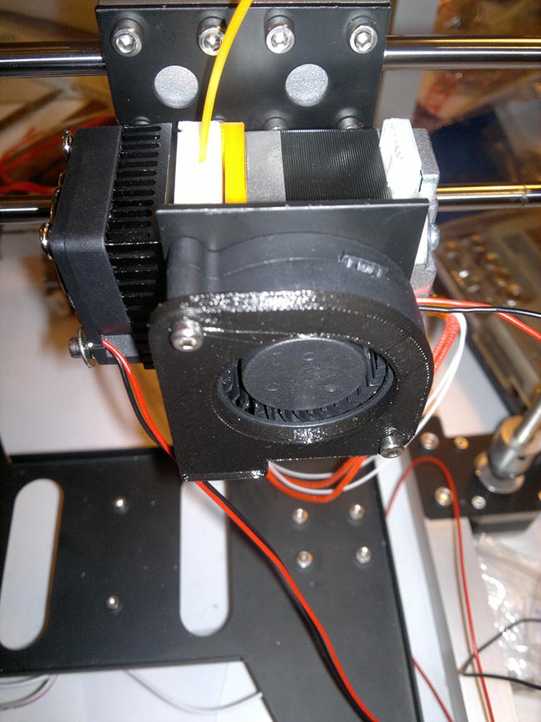

Slide 39
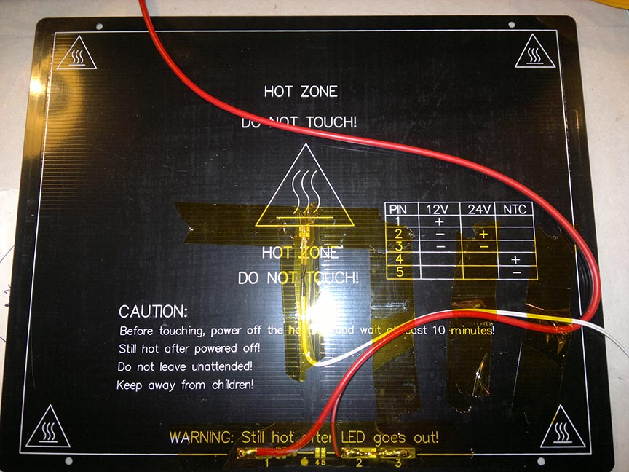

Slide 40
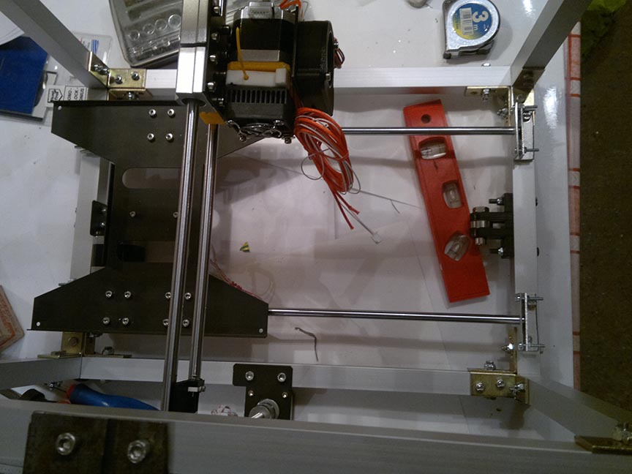

Slide 41
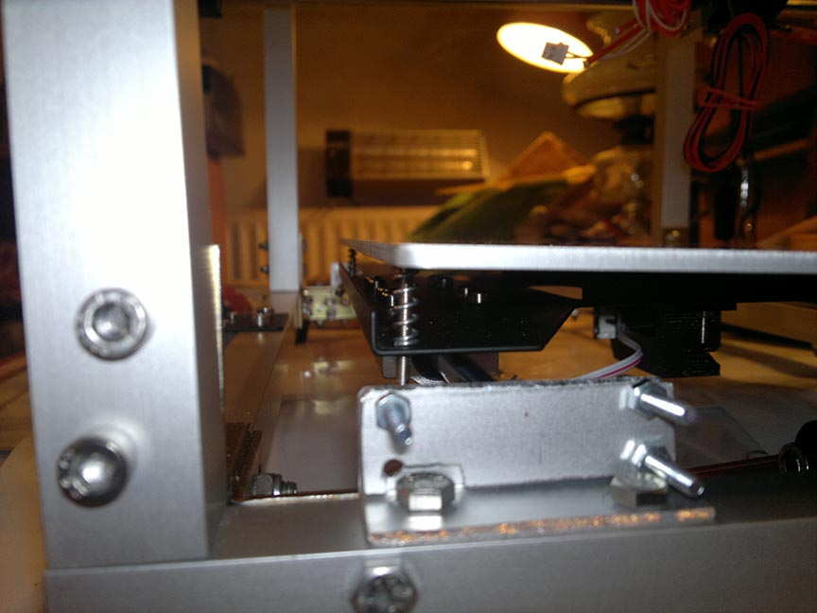

Slide 42
Electronics part

Slide 43
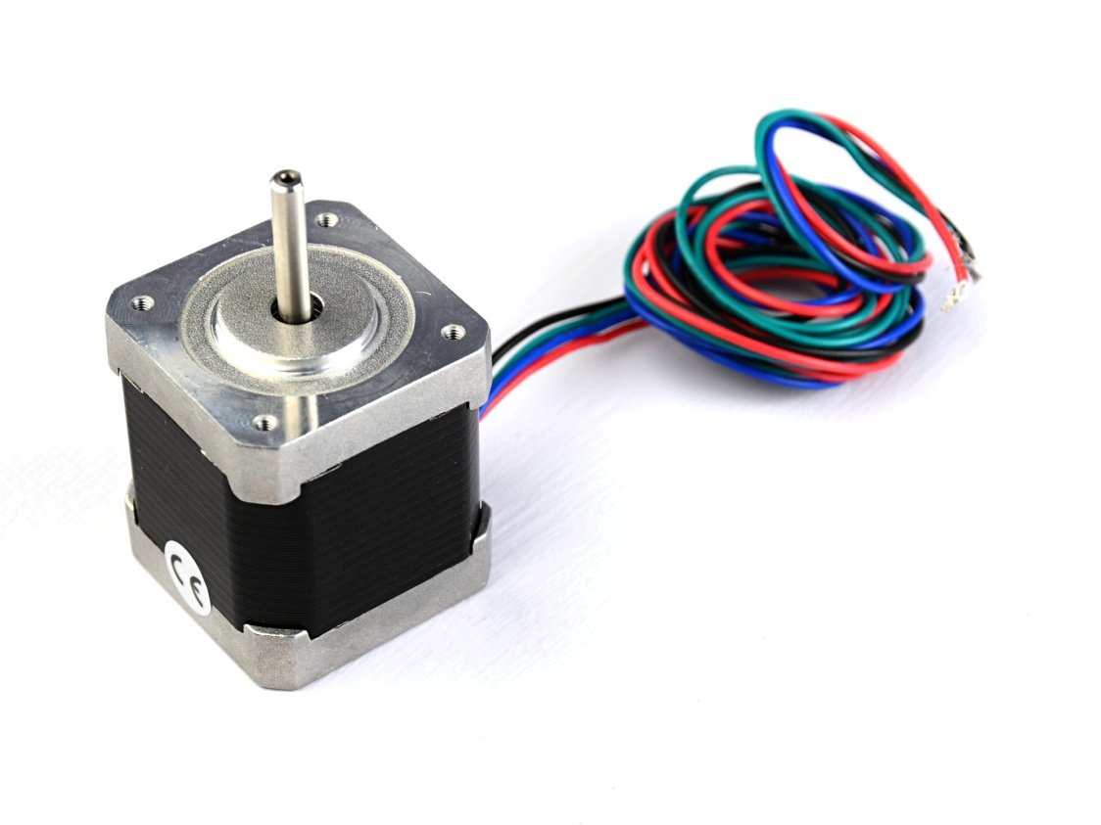
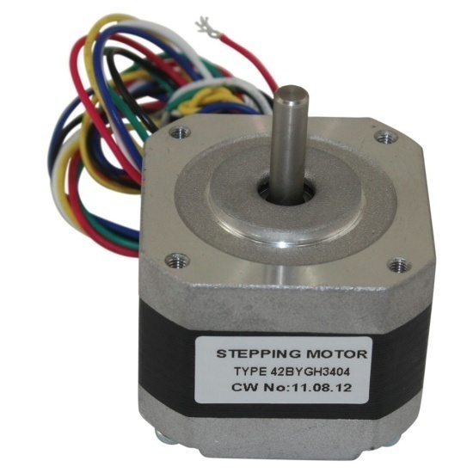
Motors
3x 40mm12V 6 watt 300 mN/m stepper motor
2x30mm 3,75 W 180mN/m stepper motor
They are Chinese NEMA17 clones.
200 step/rotation=>1.8 degrees/step

Slide 44
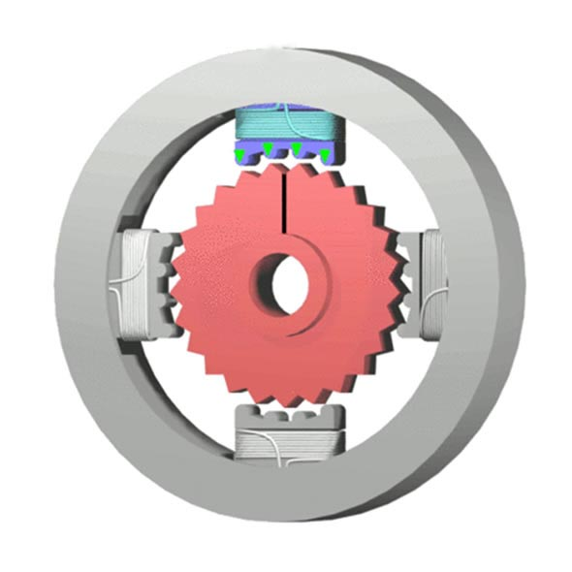
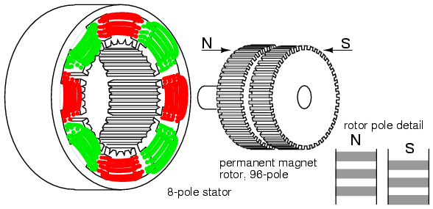
Motor control
Stator poles
Their polarity can be changed.
B ~ I
Rotor poles
Permanent magnets.
They align with stator poles.

Slide 45
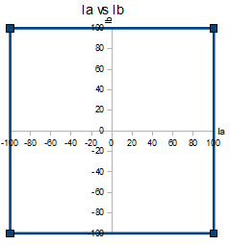
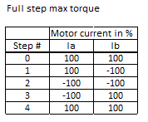
Motor control
Normal step excitation sequence:

Slide 46
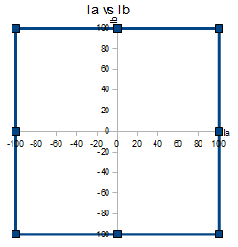
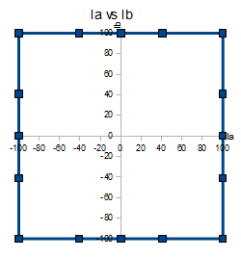
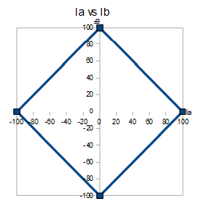
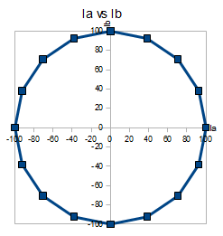
Motor control
Breaking up Ia and Ib current vectors.

Slide 47
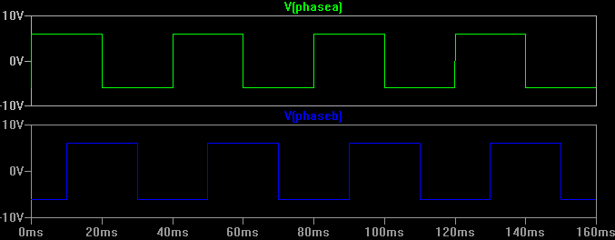

Motor control
Breaking up Ia and Ib current vectors.

Slide 48


Motor control
1/4 microstepping
Further refinement also achievable till perfect sine.

Slide 49

A4982 stamp
Inexpensive
Ready to use
1/16 microstep
Up to 20 W
Nice heatsink

Slide 50

A4982 stepper control chip

Slide 51

A4982 stepper control chip

Slide 52

A4982 stepper control chip

Slide 53

Switching high power with uC
120 W 12 V PCB heatbed
40 W 12 V heater resistor for extruder

Slide 54

RAMPS

Slide 55

RAMPS schematic

Slide 56

ARDUINO MEGA 2560

Slide 57

ARDUINO MEGA 2560 & RAMPS

Slide 58

ARDUINO MEGA 2560 solderjob

Slide 59

HESTORE ELMODULES AVR mkII compatible programmer

Slide 60

PSU: chinese LED power supply

Slide 61

PSU: chinese LED power supply
220W 230|110 V AC to 12 V DC
Line
Neutral
Protective Earth
3x COMS
3x V+
Interesting open terminals, at least it has fuses.

Slide 62

Terrifying ratnest
If I have 10 minutes untangling and plugging it in will be 10 minutes

Slide 63

Programming part

Slide 64

KISS
Not the rockband, KISS means „Keep It Simple Stupid”.

Slide 65

Modules to drive:

Slide 66

Program modules
Characters via UART are scanned into an array until a terminating character comes
In clockwork interrupt the cyclic tasks like ADC read ins are managed
For each motor there is an interrupt that makes it step, the frequency of step is the freq of interrupt, set by OCRx bits.
Housekeeper resets the appropriate variables and arrays

Slide 67
Protocol
NIST RS274NGC like interpreter
G-code or /M code sent→ ok means ack
After ok next command can be sent.
Examle: M105
Ok T:230 B:50
To move and use tool: G1 X115.521 Y185.333 Z0.400 E32.5675
Missing documentation.

Slide 68

Protocol

Slide 69

Test

Slide 70

Test

Slide 71

Test

Slide 72

Test

Slide 73


Slide 74


Slide 75


Slide 76


Slide 77


Slide 78

Thank you for your attention!

